Slide 1
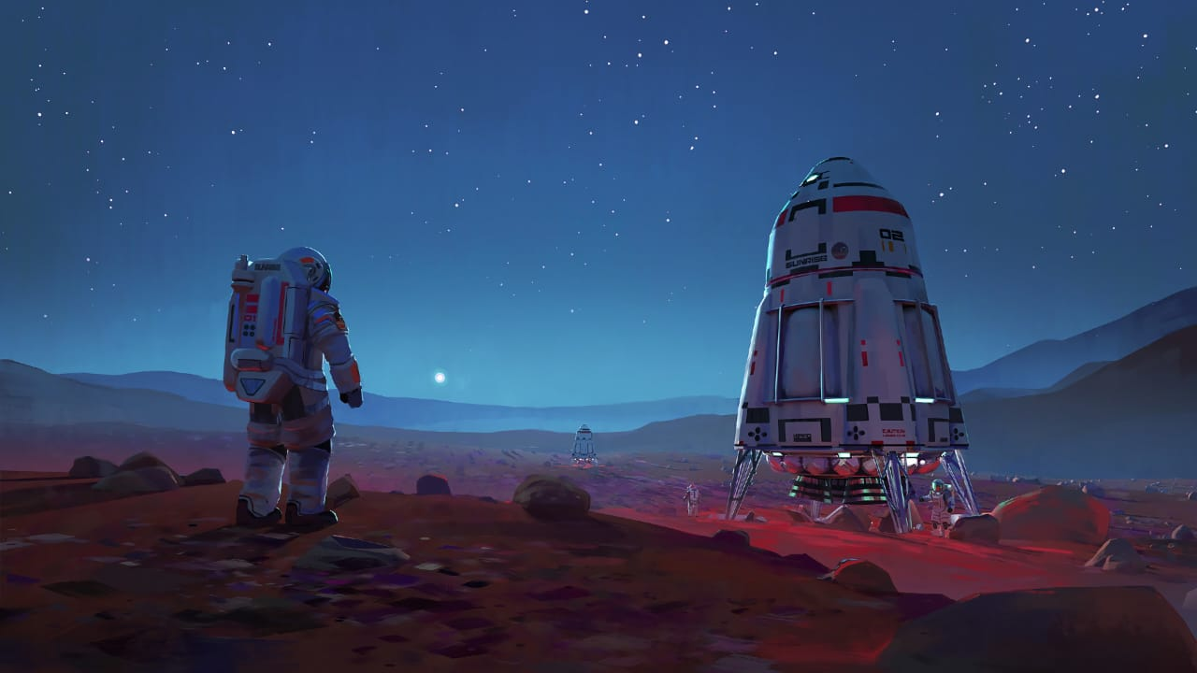
LANDING OF HUMAN ON THE RED PLANET MARS

Slide 2
SOME INFORMATION ABOUT MARS:
IT IS THE FOURTH PLANET FROM THE SUN
IT IS RED BECAUSE OF THE IRON PRESENT IN IT’S SOIL
IT LOOKS WARM BUT IT’S VERY COLD
IT HAS 2 MOONS PHOBOS AND DEIMOS

Slide 3
WHY IT IS HARDER TO GO ON THE PLANET “MARS” : DUE TO DISTANCE :- IT IS ALMOST 1000 TIMES AWAY THAN MOON. DUE TO ATMOSPHERE :- MARS HAS VERY THIN AND VERY COLD.ATMOSPHERE IT’S ATMOSPHERE CONSISTS OF (96% CO₂ 78 %NITROGEN , 1.9%ARGON, 21%OXYGEN , 1%OTHER AND TEMPERATURE AROUND -100 deg. IN WINTERS AND 20deg SUMMERS.

Slide 5
PHOBOS

Slide 6
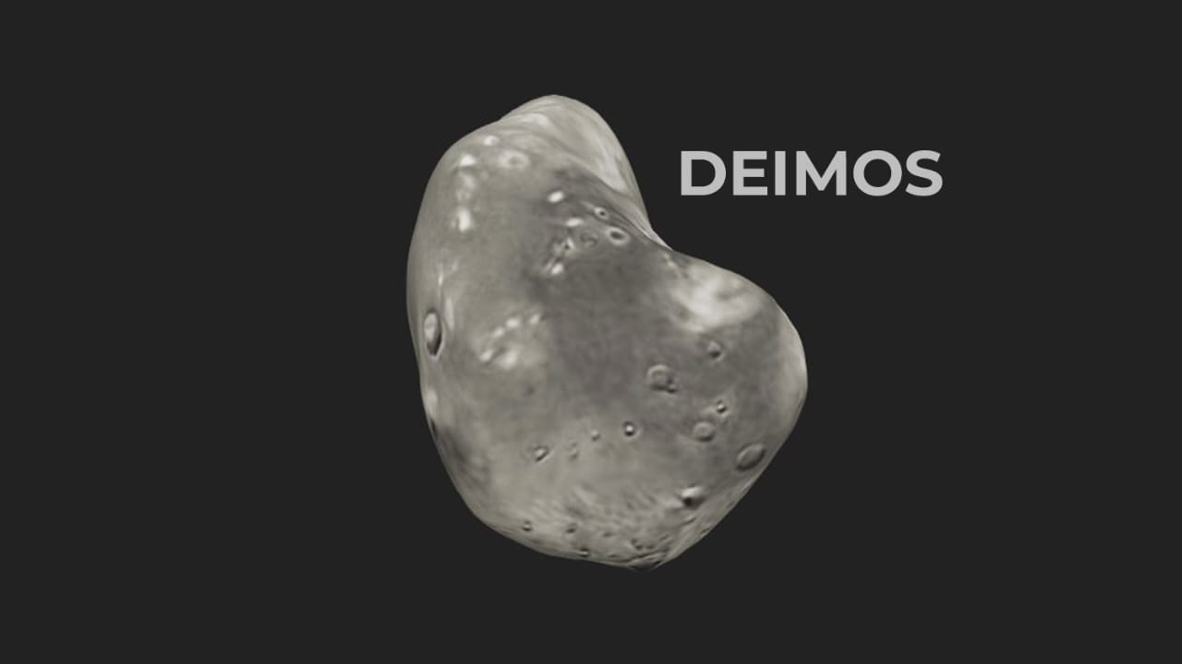
PHOBOS

Slide 7
BENEFITS OF LANDING HUMANS ON MARS
IF WE LAND ON MARS WE CAN TEST NEW TECHNOLOGIES.
THE GRAVITY ON MARS IS ONLY 38% OF EARTH’S GRAVITY SO LESS GRAVITY LESS FUEL.
TO INVESTIGATE WHEATHER MICROBIAL LIFE EXISTS THERE OF NOT.

Slide 8
COUNTRIES AND COMPANIES WHICH ARE WORKING TO LAND HUMANS ON MARS
ISRO
NASA
SPACEX
UNITED ARAB EMIRATES
JAPAN
CHINA
RUSSIA AND EUROPEAN UNION

Slide 9
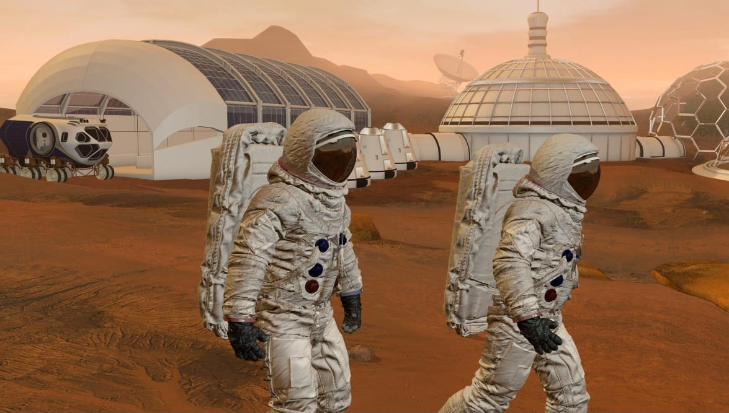
EXPECTED TIME TO LAND HUMANS ON MARS
The NASA aims to launch the astronauts to mars by late 2030s or early 2040s

Slide 10
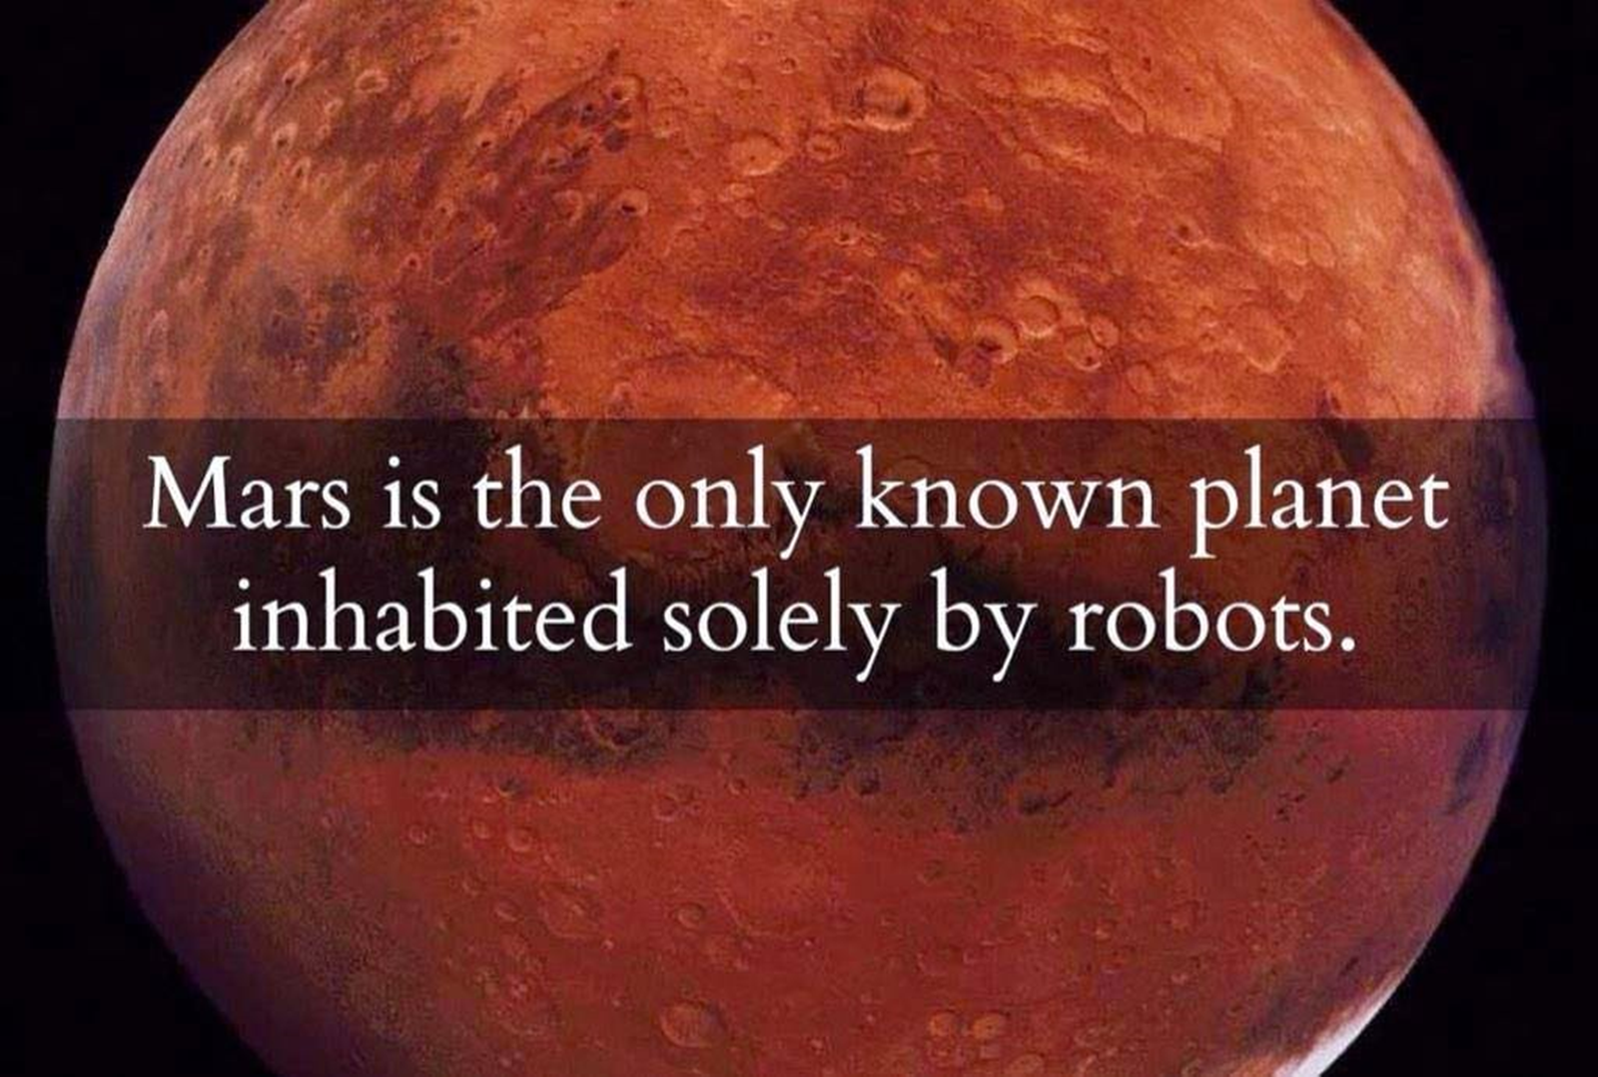

Slide 11
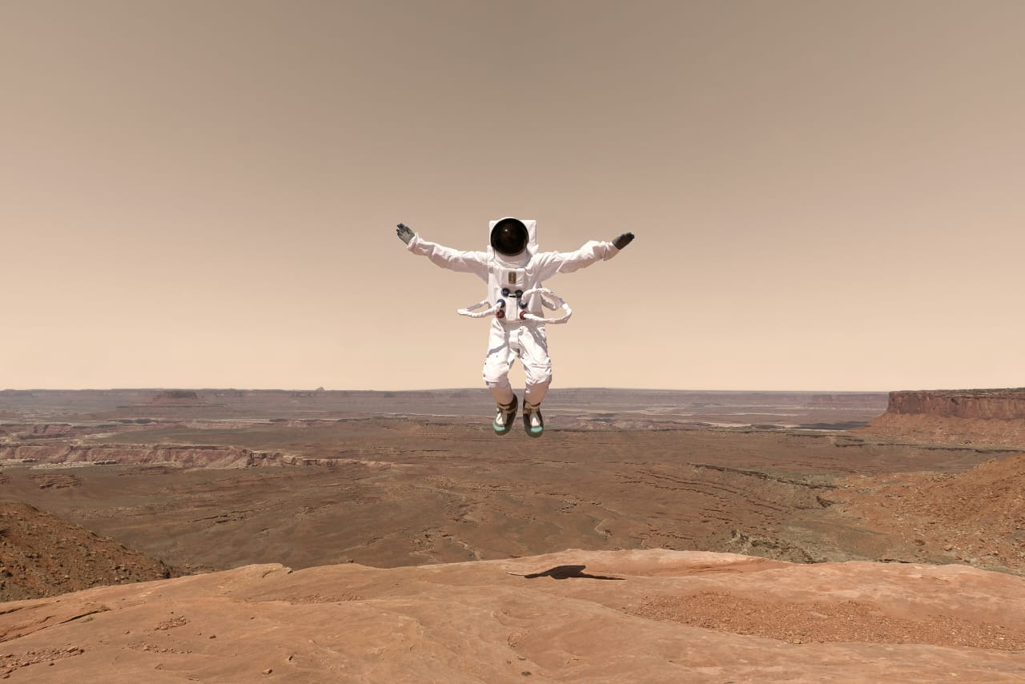
REPRESENTATION BY:-
VANSH SINGH
(2221121)
B.TECH 2nd YEAR
INFORMATION TECHNOLOGY

